Slide 1
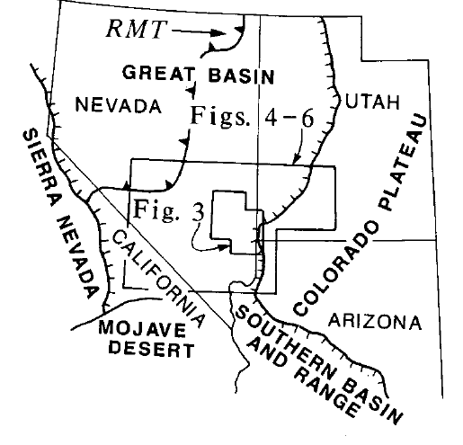
Space-time patterns and tectonic controls of Tertiary extension and magmatism in the Great Basin of the western United States
Gary J. Axen, Wanda J. Taylor & John M. Bartley, 1993
Maggie Duncan
Distribution and source of volcanics well constrained in past studies
Pre-middle Miocene crustal extension defines two N-trending belts (63 – 23 Ma)
Eastern belt: straddles NV-UT border, with western edge at Seaman-Butte Mountains breakaway
Western belt:
Focus on relationship between initiation of extension and crustal magmatism
Applied Severinghaus & Atwater’s (1990) thermal model
Notes:
Compilation of data from many other papers
Observations of timing earliest extension in Basin and Range

Slide 2
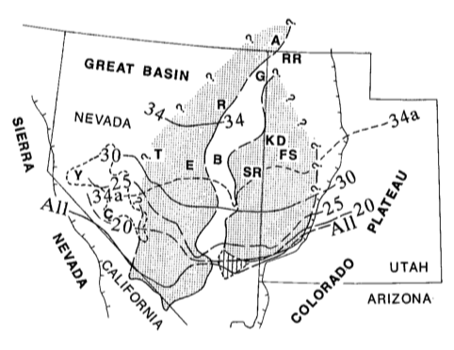
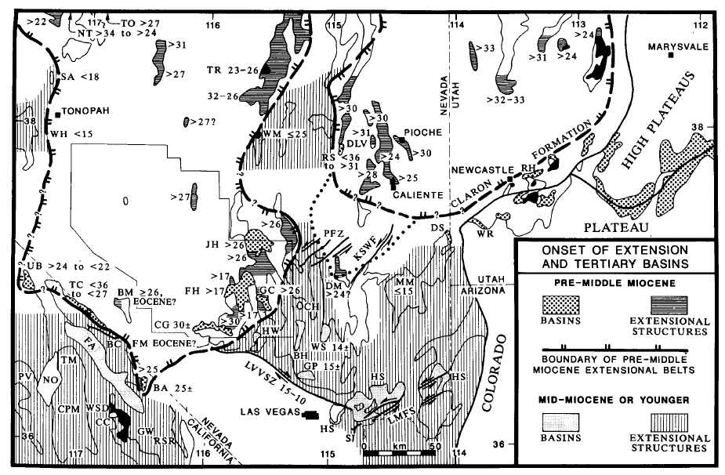
Relationship between crustal magmatism and initiation of extension
Calderas migrated southward during Oligocene in relation to Paleogene-Miocene extensional belts
Calderas preferentially form in extended crust
Effusive volcanism favored in unextended or currently extending areas
Used available geologic data, ash flow tuff extents, miogeoclinal stratigraphy
Miogoeocline: clastic wedge that forms along a passive continental margin due to sedimentation (because I forgot and maybe you did too)
Solid lines: southern extent of Oligocene caldera locations (Ma)
Shaded areas: Paleogene-Miocene extensional belts
Dashed line: likely experienced early-mid Miocene extension
Notes:
“All” = southern limit of all calderas older than 5 Ma

Slide 3
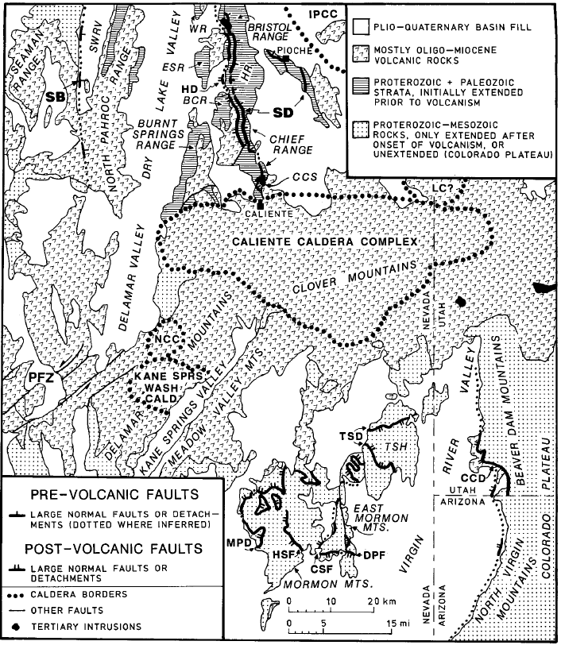
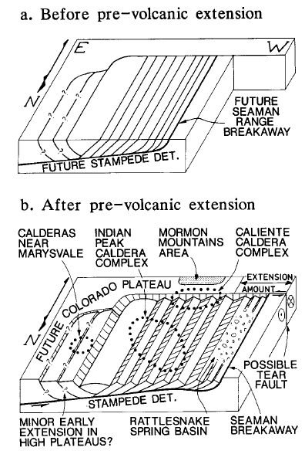
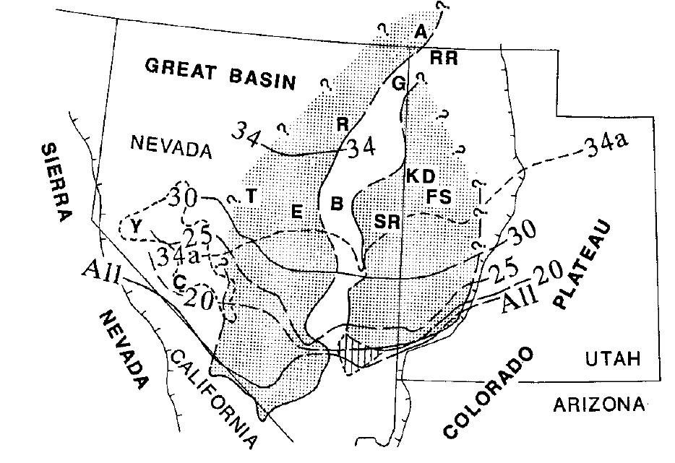
Eastern Extensional Belt
Crust N of caldera complex extended prior to volcanism (30-32 Ma)
Crust south of it began extending after ~15 Ma
Southern end of belt:
Caliente CC may have been rooted zone of L-slip faults → allowed footwall of stampede detachment to move west as rocks extended
(southern boundary)
Notes:
Boundary can be traced via structural evidence to within 50 km of eastern edge of B&R in southern Utah near St. George
Normal faults through older units and overlain by volcanics
Other evidence:
Found sediment accumulation in basins below tuffs and volcanics, indicating a basin was already present at time of eruption
Interbedding with certain fossils indicate Paleogene deposition

Slide 4
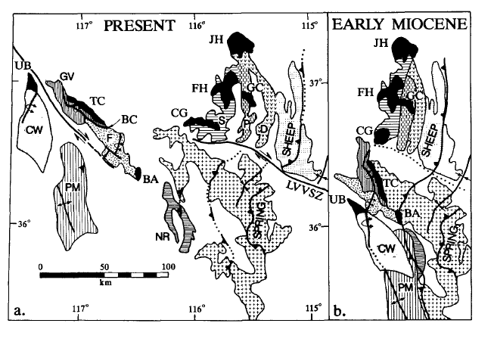
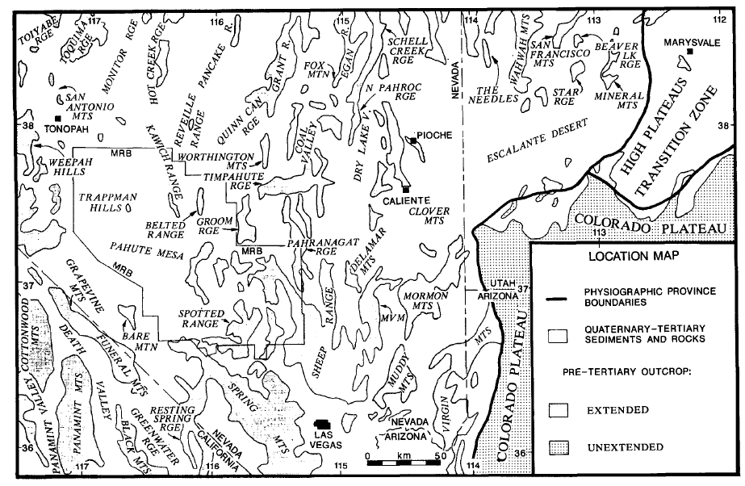
Western Belt
Fewer exposures → Early extension less constrained than eastern belt
Used stratigraphy of pre-volcanic basins to constrain caldera locations
Reconstructed
Onset of extension dominantly mid-Miocene or younger
Reconstruction of extension during early Miocene (a) and present (b). ~40 km of slip on LVVSZ, approx. equal to total distance between Cross-grain basin area and Sheep range.

Slide 5
Evidence of Prior Extension from Ignimbrites
Calderas and Tertiary intrusions mapped onto study area are evidence of existing extensional terranes
(i.e., ignimbrite accumulations controlled by paleotopography – suggests calderas confined to areas that extended pre-mid Miocene)
Ignimbrite deposits tend to follow boundaries of older extensional belts

Slide 6
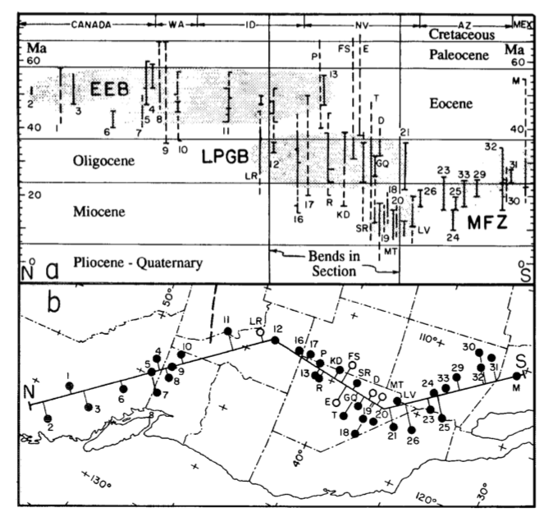
Age of Extension vs. MCC Locations
Shaded areas: discrete extension episodes (LPGB = Late Paleogene-early Miocene extension described in text; MFZ = Extension in southern Basin and Range with inferred relation to migration of Mendocino Fracture Zone). Heavy dashed line = north edge of flat subducted lithosphere slab inferred from Laramide magmatic patterns. Solid circles: location of metamorphic core complexes; Open circles: location of highly extended areas

Slide 7
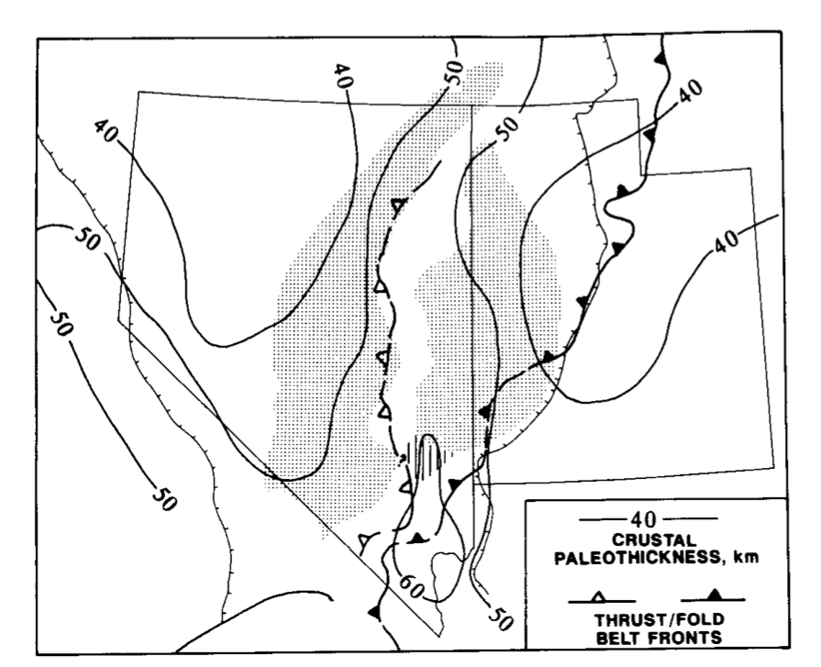
Takeaways
Late Paleogene-early Miocene extension formed two N-S trending belts in Great Basin
Dominantly Oligocene
Subparallel to Sevier thrust front (Mesozoic-Cenozoic) and central NV thrust belt (Jurassic)
Extension began ~32-30 Ma in north (post/syn-volcanic), and after 15 Ma in south (pre-volcanic)
Crustal magmatism spread south over time
Southward migration appears to have stalled at end of belts (unextended crust)
Eruptive style controlled by extension of crust
Most calderas formed in previously extended crust
Tertiary volcanism started in N in Eocene (effusive), then moved S in Oligocene-Miocene (ignimbrite eruptions)
Space time patterns of Paleogene extension consistent with thermal weakening
NOT effects transmitted from the plate margin
Extension and magmatism only locally associated spatially/temporally
CNV thrust
Sevier thrust
Notes:
Major trend of southward decrease in age of extensional tectonism in both belts

